Slide 1
2026 RAILS Training
Digital Intelligence
August 2026

Slide 2
What is RAILS
Robust, Agile, Integrated, Lifecycle System is the process by which INITIATIVES move from Inception to Delivery and into Support.
Applies to all P&L’s / Sub-P&L’s in the Digital Intelligence organization
It is fundamentally a BUSINESS PROCESS to establish lines of communication and help ensure Cross Functional involvement and review.
It is used for ALL* Initiatives … Maintenance developments for existing products, small or large customer funded requisitions, product evolutions, new product development
RAILS is designed to support appropriate tailoring with appropriate oversight
Reduces RISK in projects, improves actual costs, improves customer quality
Drives Cross Functional Alignment … we act together as one team
* Except Flow Projects
Notes:
*

Slide 3
A Note about ROLES versus TITLES
Throughout this training we will reference ROLES as having certain responsibilities
During some projects, the people filling some of those ROLES may not have the same job title … that is OK.
We just need to make sure someone is ASSIGNED responsibility to fulfill that ROLE for this project.
For Example:
  In a project which falls below the DOA levels, the Product Manager will fulfill the ROLE of comm-ops to ensure the ITO-OTR handoff occurs
  In projects which are not complex or large enough to have a dedicated project manager, someone will still need to shepherd this project to completion and manage cross functional coordination … that person is fulfilling the role of project manager.

Slide 4
RAILS Lifecycle Stages Intents & Highlights
Initiative Charter
CP0
Does the potential benefit justify the effort to estimate & plan the development.
The goal is to screen out low value opportunities. It is REQUIRED only for Highest Risk
projects.
RAILS 0
Business Case
CP1
Determine concept, requirements, estimate and schedule constraints
Precursor to bid … make sure we can deliver to the commitments
Resources FORECAST here … factoring in risk & win probability
Deal Review includes development of Bid Strategy*
RAILS 1
Deal Review
Project Kickoff
CP2
Project kickoff … ensure team is aligned to actual commitments after negotiations … what changed from the initial estimate & plan
Resources COMMITTED here … by group, maybe name
RAILS 2
Dev and V&V
CP3
Cross functional (Engineering, Supply Chain, Services, etc) execution
Ends with PILOT Release Readiness … with business alignment
RAILS 3
Pilot Test & Prod Ready
CP4
Complete pilot or user acceptance testing, and make any necessary adjustments
Ends with Production Release Readiness
RAILS 4
*note deal review governed by ITO process not RAILS

Slide 5
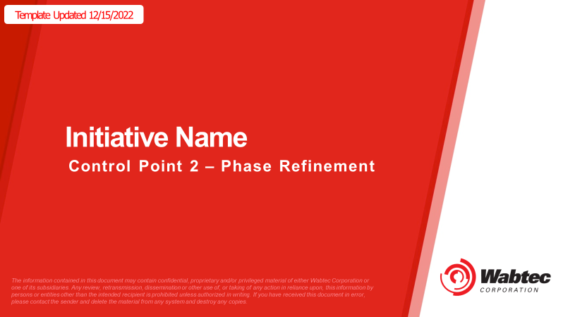
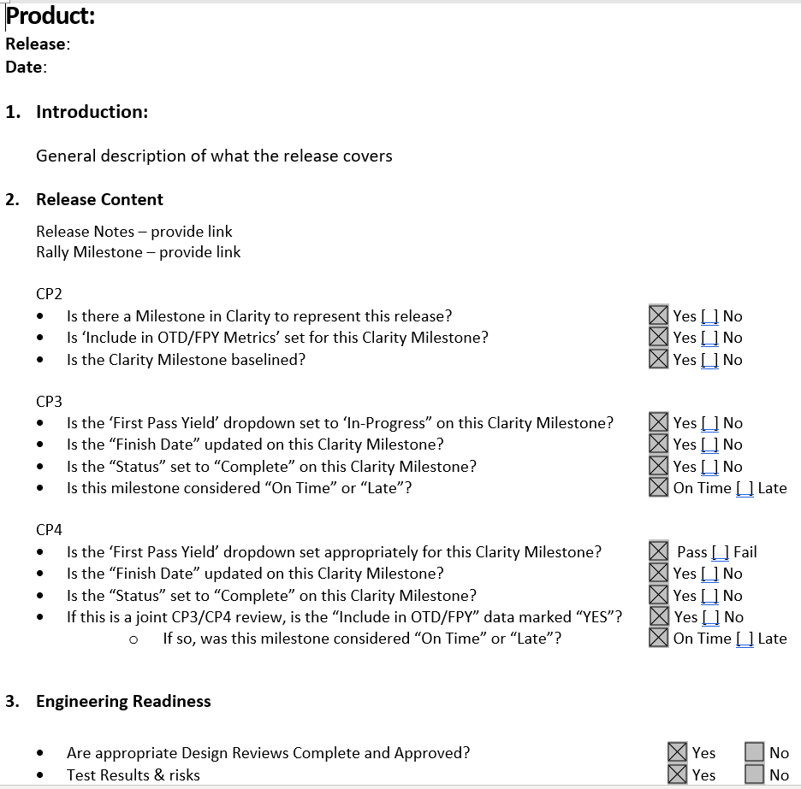
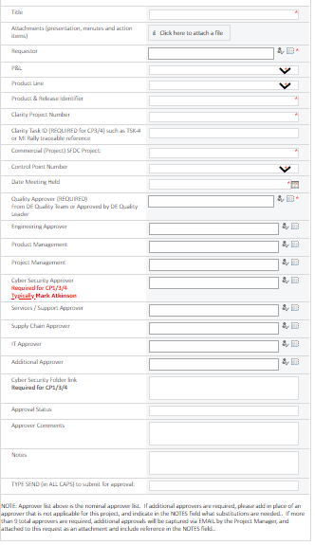
RAILS & CONTROL POINT REVIEWS
Control Points are formal RISK reviews:
  Held at the end of each RAILS program lifecycle stage, prior to commencing the next one
  Content Tailored based on project risks & status … tell us what we need to know
  Risks are clearly communicated and understood … make go / no-go decisions
  Risks should be specific and actionable… “Need System Engineer to define requirements for Feature 3” not “I may need more resources.”
  Cross functional in nature … we all agree to move forward together
Example templates provided … but format is not required … content of review is critical
Approvals are captured in SharePoint workflow
Control Points help break any silos, increase focus on customer deliverables, reduce risk and improve quality

Slide 6
Approvals for Control Points
Role | Notes
Quality | Always required
Project Manager | Required EXCEPT CP0
Product Manager | Always Required
Engineering | Always Required
Supply Chain / Operations | Required if any HW necessary
IT | Required if there are any IT changes / buildout required
Safety | Required EXCEPT CP0
Services / Support | Required when Services is involved (most of the time)

Slide 7

RAILS 0 from Concept to Charter
Owner: Product Manager
Idea / Opportunity Initiation
Concept may come from:
Customer Requested Features
Customer Problem Definition
Internal brainstorming – Product Manager, Engineering, Service, Manufacturing, etc.
Ideation sessions
Initial Risk Assessment
Present Idea / Opportunity to Product Manager
No /
Not Now
Funding Decision
RAILS 0
More Data needed
Put on Hold
RAILS 0 is about preliminary understanding:
Product Management Team
Understanding the initial concept
Initial assessment of market & competition
Where would we be positioned & what is the value story
Engineering
Is it feasible?
Very high-level concept & requirements
ROM Schedule & costs
Market Research / Competitive Landscape
Yes
Preliminary Concept, Req’ts and Interactions
Product Differentiation & Value Story
Tech feasibility assessment & ROM cost / schedule
CP 0 Review -> Proceed to RAILS1?
RAILS 0 is only required if the risk assessment demands it!

Slide 8

RAILS 1: Refining the Concepts to Deciding to Bid
Owner: Project Manager
CP 0 Approved / Waived
Market Research / Competitive Landscape
Yes
Refined Concept, Req’ts and Interactions
Product Differentiation & Value Story
Tech feasibility assessment & HC cost / schedule
RAILS 1 is about refining understanding & establishing plans:
Product Management Team
Refining Product Needs & market strategy
Understanding value story & pricing strategy
Developing bid strategy
Engineering, Safety & Project Management
Refining Concepts & Requirements, including structural or data changes to interfaces identified
Developing Schedule Constraints / Development model
Establishing High Confidence effort estimates
Operations & Services
Establishing plans for production / support
Establish Bid Strategy
CP 1 Approved
Change Requested
Yes
No
Deal Review
Approved
On Hold / No Bid
No
Yes
Bid to Customer … if win go to RAILS 2
No Win

Slide 9
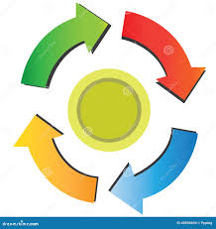
Between Bid and Win … Collaborating to Win & Deliver
Customer asks for changes / Wabtec assess interests
Other projects Bid / Win % updated
Environment may drive changes to bid (Delivery timing)
Bid to Customer
Customer places order
Projects won / Resources change
Technology Roadmap evolves
Teamwork makes the dream work … equal parts science & art!

Slide 10

RAILS 2: ITO to OTR & Project Kickoff
Owner: Project Manager
INTP or Purchase Order / Contract received
No … Work with PM / Comm Ops to adjust commitment
ITO team communicates win / options
System / product team refines concept
Assumption held
through cycle?
Requirements refined, at least system / product approved
Project handoff package:
Highlight changes from initial CP1 content / plans
Clarify options selected, timelines committed
Prepare for Kickoff meeting
Engineering refines concept and requirements to provide more detail & confirm if any changes will be needed to interfaces (structural or data)
Project management establishes cross functional plan including key dates and handoffs
Compliance includes Cyber Security, Safety, and other regulatory requirements
Within 2 weeks of Purchase order acceptance SHALL confirm if our basic assumption held through the Bid / Win cycle?
Yes
Project Manager develops schedule & budget
Compliance Requirements established
Hold Control Point 2 & Kickoff Meeting

Slide 11

RAILS 3: Development and V&V Through Pilot Release
Owner: Project Manager
Control Point 2 Approved /Kickoff meeting held
“Engineering‑owned execution with PM coordination”
Project Manager drives cross functional interactions
Design Solution
Multiple parallel streams …
Project Manager is actively managing schedule / risk matrix
Engineering is developing Product / Solution (Hardware & software activities coordinated to ensure full business readiness)
Supply Chain develops approved suppliers, test fixtures, work instructions, Supplier Life Cycle Management
Product Management develops launch plans for new products
Services develops spare strategy, training, resources
IT establishes infrastructure & Cybersecurity analysis and vulnerability remediation plans if any
Culminates when everyone is able to support PILOT / Field Test / Critical Design Review (CDR)
Execution may be iterative (RAILS 3A/3B/multiple milestone drops). Refer next slide for more details.
Project Manager manages risk management
Implement Solution
Includes planned reviews
Project Manager actively maintains schedule
Test Solution (V&V)
Periodic Process Audits
Engineering Release Readiness Review
Note: Refer next slide for CP3 Decision Gate
Pilot/Field Test / CDR Required ?
No
RAILS 3+4
Production Release
Readiness Review
Yes
Pilot /Field Test / CDR Release Readiness Review
(CP3)

Slide 12
RAILS 3: Development and V&V Through Pilot Release
Engineering Release Readiness proves the solution is technically ready; CP3 determines how far that solution is allowed to go into the customer environment.
CP3 DECISION GATE
Engineering Release Readiness Review Passed
No
SW Testing in Customer Environment
Before production release?
Key Point:
CP3‑Restricted is not a Pilot gate — it is a pre‑Pilot engineering accommodation.
Proceed to RAILS 4
(Skip CP3)
Yes
Yes
Formal CP3
(Pilot Release
Readiness Review)
Pilot / UAT / CDR
Aspect | CP3‑Restricted | Formal CP3
Purpose | Customer integration testing only | Pilot / UAT / CDR approval
Environment | Customer non‑production (restricted use) | Customer production / staging
Production usage | ❌ Not allowed | ✅ Allowed (controlled)
Test scope | Integration only | Customer acceptance / Pilot
Defects logged as | Internal defects | External defects (escapes)
Metrics tracked | Yes (restricted criteria) | Yes (standard CP3)
Required for Pilot? | ❌ No | ✅ Yes
No
Preliminary Customer Integration Testing Release
Conduct Restricted CP3
No
Yes
Integration Testing
Completed?
CATO: Not Required
CATO: Required

Slide 13
Quality Audit for Release Readiness Reviews
Engineering & Technical Reviews:
  Technical reviews must include- Who reviewed, When the review occurred, Minutes/outcomes, Actions tracked to closure
  If a design review is not required, an affirmative statement is required stating why
  Testing Expectations:
  All required Wabtec tests completed and reviewed
  Manual testing- Evidence of execution, Results reviewed and approved
  Automated testing- Automation must be validated and approved, Pass / Fail results are acceptable once automation is approved.
  Defects/Backlog Status:
  All defects and user stories must be in a terminal state
  Deferred defects must be: Documented, Reviewed by Engineering and Product Management, High‑impact defects communicated and approved (including by customer if applicable)
  Release Readiness – Objective Evidence Required:
  All readiness assessments must be supported by objective evidence
  Evidence must be reviewable by someone independent of execution
  “Work completed” statements without evidence are insufficient
  Clarity Milestones and Metrics Enabled:
  All Control Points or Milestones have dates in Clarity.
  Appropriate flags enabled for OTD, FPY, COPQ, etc.
Note : Approval confirms readiness for Pilot / Field Test / CDR. Approval does not imply zero risk — it confirms risk is understood and accepted
Based primarily on YOUR Processes and DOD

Slide 14

RAILS 4: Hold Pilot through Production
Owner: Project Manager
Control Point 3 held
Work with customer to complete PILOT \
Commissioning and cutover
Complete customer Pilot / User Acceptance Test / Commissioning and Cutover (Systems Projects)
Purpose: evaluate the information from the initial deliveries, including both internal review of data, and customer feedback, and evaluate if it is acceptable to deploy this product or project in revenue service
Review and approve changes between pilot and production or submittal and customer acceptance
Ensure full business is ready to support production, for ex.: FAI / PPAP completed; Spares strategy in place; Volume manufacturing capable; Training material in place; Market launch materials available; Defect tracking system in place and working
Hold Control Point 4
After CP4 is approved, schedule a Lessons Learned Review with the team within 4 weeks.
Assess need for change (return to R3 if appropriate)
All functional teams complete activities to support production quantities
Production \ Project Release Readiness Review
Schedule / Hold Lessons Learned

Slide 15
System of Systems Projects & RAILS Interactions
Increasingly our projects impact multiple teams / product lines …
- Ex: Signaling Project requiring IVOC, TCOS, IETMS
RAILS needs to support coordination & alignment of commitments between each other and to customers … Some projects will need multiple interacting RAILS projects
If all components are within one sub-P&L, Project Manager can evaluate if additional RAILS project adds value or if they will manage in one project – defined at RAILS 1 reviews
System of Systems (or System if standalone project)
Charter
CP0
Scope / Est
CP1
DEAL REVIEW / DOA
Launch
CP2
Dev / V&V CP3
System Rel Read.
CP4
Component Systems (if SOS effort) -> 1 per component systems
Scope / Est
CP1
Launch
CP2
Dev / V&V CP3
Prod Rel Read.
CP4

Slide 16
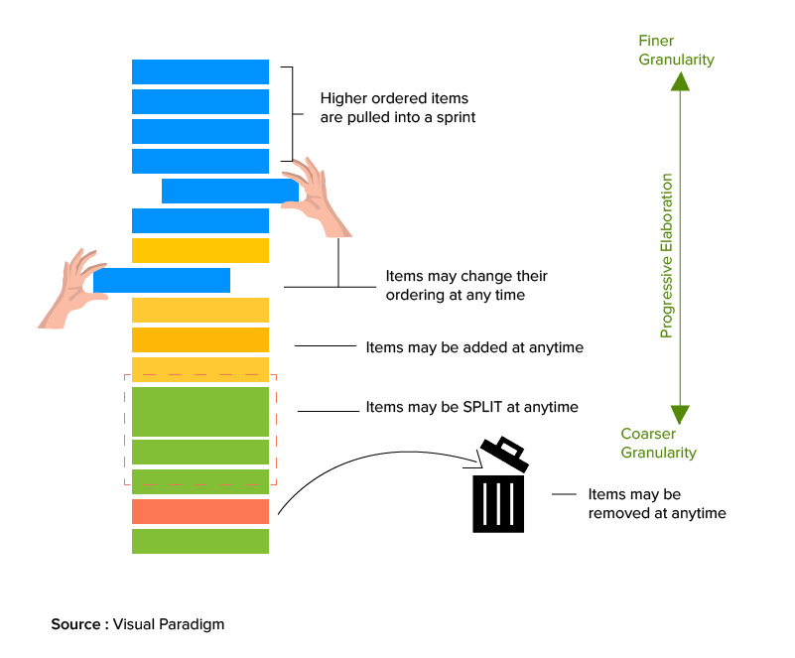
Managing Sustaining Projects / Pooled Resources
What are Sustaining Projects?
Projects which are funded / supported by a shared pool of dedicated resources specifically approved to work sustaining projects
Changes must be low risk, and include only SMALL feature enhancements or defect fixes
Project CANNOT have customer committed delivery dates … work based on backlog prioritization (prior to CP2, see below)
CP1 – Approved before SEP-NOV Budget Cycle. Cover the Product Plan and high-level requirements (including Cybersecurity, safety, etc.) for upcoming year, End-Of-Life Planning, size of team, budget, risks and downstream CP responsibilities (identify the resources responsible for CP2/CP3/CP4).
CP2 – Kicks off specific delivery plan … establishes content of projects based on backlog, timing for release. AFTER CP2 is approved, customer may be provided a committed date.
  Once communicated to customer … the date & scope cannot be changed due to other requests.
  Teams using PI Planning process can waive the separate CP2 reviews, provided Safety and Cyber security requirements taken care, risks identified and discussed in PI, and delivery milestones created in Clarity and reported in PI Closure meeting. CP2 approval will be documented by loading the PI Plan into the CP site and getting appropriate approvals.
CP3/4 – Release Readiness Review as with all projects

Slide 17
Cases Where CP2-Revisit Not Needed
Refer to DI-S-QUA-323 Digital Intelligence Scope Change Management Procedure

Slide 18
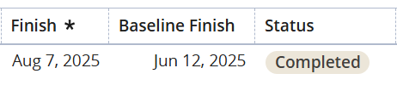
Changing a Rebaseline Date
To change a BASELINE DATE, a revised CP2 is required moving forward, even if the change does not trigger our official Scope Change policy.
Program/Project Leadership can update a rebaselined date only when driven by external or Customer justification, such as additional features or scope, or delayed schedule commitments FROM the customer.
Last minute defects, design changes, project reprioritization, lack of contingency, etc. are NOT reasons for rebaselining a date.
  The Finish Date would be updated, but the rebaselined date would stay the original committed customer date.

Slide 19

FLOW Projects are Exempt from RAILS
Low risk projects with minimal / no impact on other efforts that are better managed through another process (PO for instance)
Absolutely no: SW changes / Certification Changes – for HW must have shipped this product to that country previously
Changes must be staffed by a “Ready to Serve” team
Description | Group Affected | Limitations
Second Source / OBSO for simple / non critical components, New Part numbers | All HW | No Certifications impacted
License Extensions for more users | LAD, NO, TCOS, ST | Does not drive SW changes
License Agreement for longer duration | LAD | No new Features committed
Same SW / HW to Same customer at the Same site | TPA, LAD | No new countries / certifications
Configuration changes for values previously tested and approved | ALL | Minimal testing required (typically < 2 days total) Requires independent V&V, review and signoff Appropriate Config. Mgmt. Quality audit (if requested)
Config changes for values previously tested & approved, Excluding new countries or new industries | DM
Data only updates (including display, Subdiv files) | NO, ST, TCOS, TS
New Data feeds supported | PORTS only
Task orders covered under an active over arching contract that guides volume / capacity | S&S | Cannot impact other resources
When in doubt, Ask Quality team members

Slide 20
Connection to “Other” processes & corporate policies

Slide 21
Integration with Engineering Mapping Process
Overall Development Process (V Model, Agile, Kanban, SAFe, etc.)
Project Decomposition Process (System to Subsystem, Capabilities to Features, etc.)
Requirements Management
Configuration Management
Design Process
Defect Management
Implementation / Integration Process
Verification & Validation Process
Engineering Project Management
Technical Review Process
Engineering Release Readiness Process
Formal Release Process
Change Control Process for Projects
FMEA Process
Root Cause Analysis Process
Cyber Security Process
Special Processes – as needed by organization (Safety for instance)
For Example:
Technical review Process Description:
Defining how and when technical reviews are conducted, who can review and where / how they are documented
Requirements:
All new, or modified, technical work products must be reviewed
Reviews must be planned
Review participation is selected based on risk assessment of the changes
Review minutes must be captured, and action items tracked to closure
Review minutes must be easily accessed from the element driving the change

Slide 22
Accelerating the future
of transportation

Slide 23
Links
Resources
Reliance
CP SharePoint
DI-F-QUA-300 [Templates]
DI-I-QUA-300:304 [Work Instructions]
DI-P-QUA-260 [Pre-Production Release Types]
DI-S-QUA-323 [Scope Change Procedure]

